Slide 1
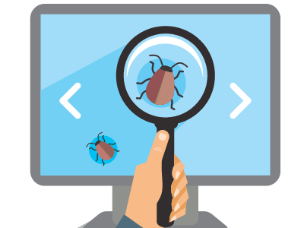
Testing Introduction
Seven Testing Principles and Test Process
SoftUni Team
Technical Trainers
Software University
http://softuni.bg

Slide 2
Table of Contents
What is Testing?
Importance of Software Testing
Seven Testing Principles
Test Process
Psychology of Testing
Software Development and Testing

Slide 3
You Have Questions?
sli.do #QA-Fund

Slide 4

What is Testing?

Slide 5

What is Testing?
The process of exercising software
To verify that it satisfies specified requirements and to detect errors
The process of analyzing a software item
To detect the differences between existing and required conditions
To evaluate the features of the software item

Slide 6


Software Testing
Software Testing is a way to
Assess the quality of the software
Reduce the risk of software failure in operation
It includes
Test planning and analyzing
Designing and execution
Reporting and evaluation

Slide 7

Testing Objectives
Main objectives of testing
Prevention of defects
Verification of all specified requirements
Verification of the expected behavior of a software
To reduce the level of risk of inadequate software
To provide information for stakeholders
To comply with contractual, legal or regulatory requirements

Slide 8

Testing vs. Debugging
Testing shows failures caused by defects in software
Testers are usually responsible for testing
Debugging is a development activity that finds and fixes defects
Debugging is usually done by developers

Slide 9
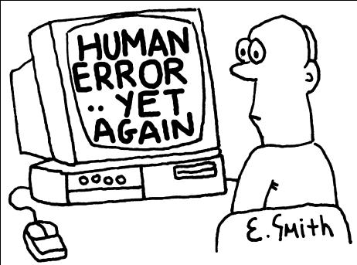
What Could Cause Incidents? (1)
Reasons for the existence of defects / bugs
Human beings can make errors (mistakes)
The cause of human mistakes might be
Poor training
Time pressure
Code complexity
Complexity of infrastructure
Changing technologies

Slide 10

What Could Cause Incidents? (2)
Organizational factors
Inefficient communication
Unclearly defined requirements
Environmental conditions
Radiation, magnetism, electronic fields, pollution, etc.
These can change the hardware conditions

Slide 11
What Could Cause Incidents? (3)
Other causes of incidents include:
Misconfiguration or failure of the test environment
Corrupted test data
Bad tests
Invalid expected results
Tester mistakes
According to the test policy any type of incident can be logged for tracking
Notes:
Book: Foundations of Software Testing ISTQB Certification - 5.6 INCIDENT MANAGEMENT

Slide 12

Importance of Software Testing

Slide 13

Importance of Software Testing
Software Testing contributes to the quality of the components or systems
Makes sure that the software meets contractual or legal requirements
Software testing could reduce costs significantly
Testing of software can save lives

Slide 14
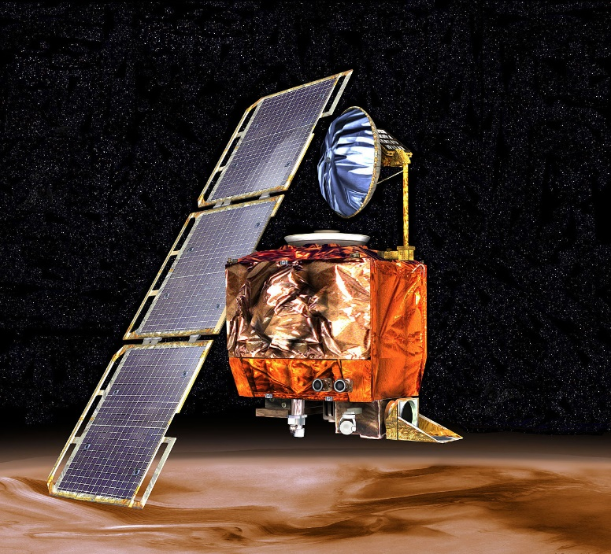
Most Crucial Software Bugs (5)
Mars Climat Orbiter Crash (1998)
Designed to study the Martian climate, atmosphere, surface
Expected to be on 140-150km from the planet
Reached 57km and was destroyed from the pressure
COST: $125 million
Reason: Incorrect measurement usage (imperial versus the NASA specified ones)

Slide 15
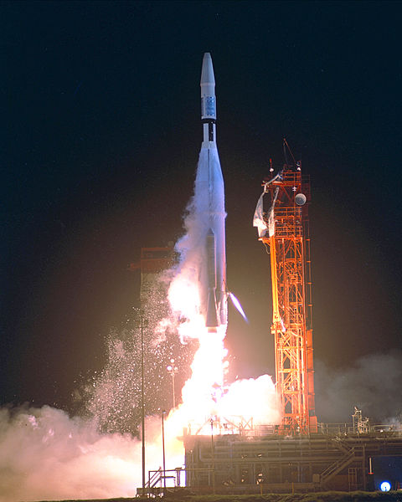
Most Crucial Software Bugs (4)
Mariner I space probe (1962)
Mariner 1 was the first spacecraft of the Americans Mariner program
Designed to explore Venus
Faulty application of the guidance commands
Destroyed 5 minutes after launch
COST: $18.2 million
Reason: The overbar's resemblance to a hyphen ('‾' versus '-')

Slide 16

Most Crucial Software Bugs (3)
Ariane 5 Flight 501 (1996)
Europe’s newest unmanned satellite-launching rocket
Destroyed 36.7 seconds after launch
COST: $8 billion with carrying $500 million satellite
Reason: Software tried to cram 64-bit number in 16-bit space which resulted in overflow conditions
Video: https://youtu.be/qnHn8W1Em6E

Slide 17
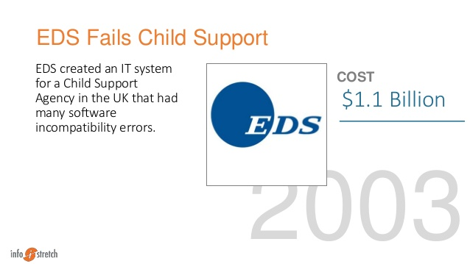
Most Crucial Software Bugs (2)
EDS Fails Child Support (2004)
IT system for the UK Child Supporting Agency
Department for Work and Pensions restructured the entire agency
Incompatibility between the restructure and the new software - 500 bugs reported
Result: Overpay 1.9 million people, underpay another 700K, had $7 billion in uncollected child support payments
COST: $1.1 billion

Slide 18
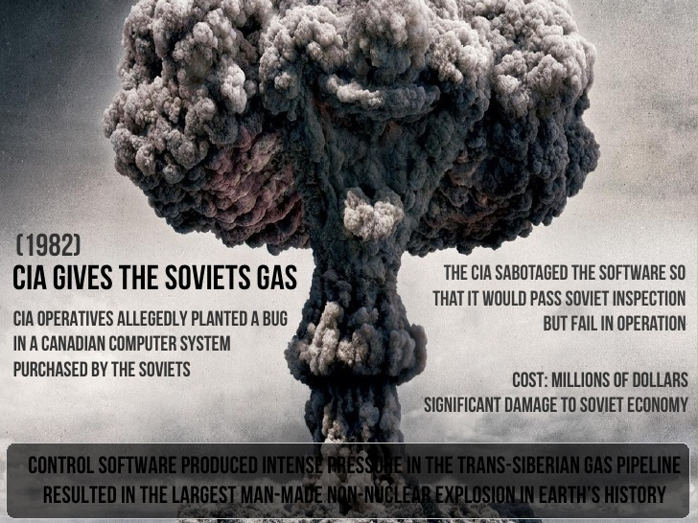
Most Crucial Software Bugs (1)
Soviet Gas Pipeline Explosion (1982)
CIA discovered that Soviet Union was trying to steal sensitive US technology for its operations of their trans-Siberian pipeline
CIA introduced bug into the Canadian built system (expected to pass Soviet inspection but fail when in operation)
Result: The largest non-nuclear explosion in the planet’s history

Slide 19

Seven Testing Principles

Slide 20

Seven Testing Principles (1)
"Testing shows presence of defects, not their absence"
Testing can show that defects are present
Cannot prove that there are no defects
Appropriate testing reduces the probability for defects

Slide 21

Seven Testing Principles (2)
All combinations of inputs and preconditions are usually almost infinite number
Testing everything is not feasible
Risk analysis and priorities should be used to focus testing efforts
"Exhaustive testing is impossible"

Slide 22
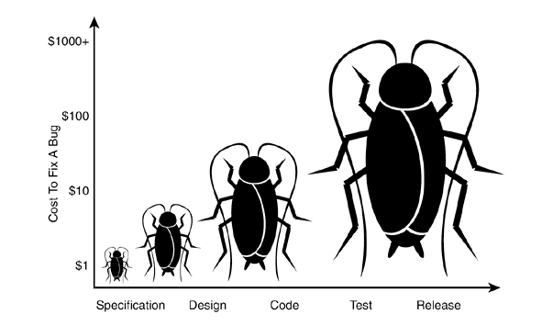
Seven Testing Principles (3)
"Early testing saves time and money"
Testing activities shall be started as early as possible
And shall be focused on defined objectives
The later a bug is found – the more it costs!

Slide 23

Seven Testing Principles (4)
"Defects cluster together"
Testing effort shall be focused proportionally
To the expected and later observed defect density of modules
A small number of modules usually contains most of the defects discovered

Slide 24
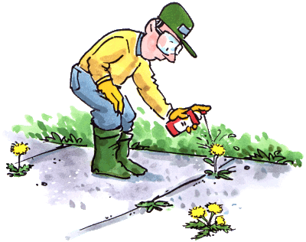
Seven Testing Principles (5)
"Beware of the pesticide paradox"
Same tests repeated over and over again tend to lose their effectiveness
Previously undetected defects remain undiscovered
New and modified test cases should be developed

Slide 25


Seven Testing Principles (6)
"Testing is context dependent"
Testing is done differently in different contexts
Safety-critical software is tested differently from an e-commerce site

Slide 26

Seven Testing Principles (7)
"Absence of errors is a fallacy"
Finding and fixing defects itself does not help in these cases:
The system built is unusable
Does not fulfill the users’ needs and expectations

Slide 27
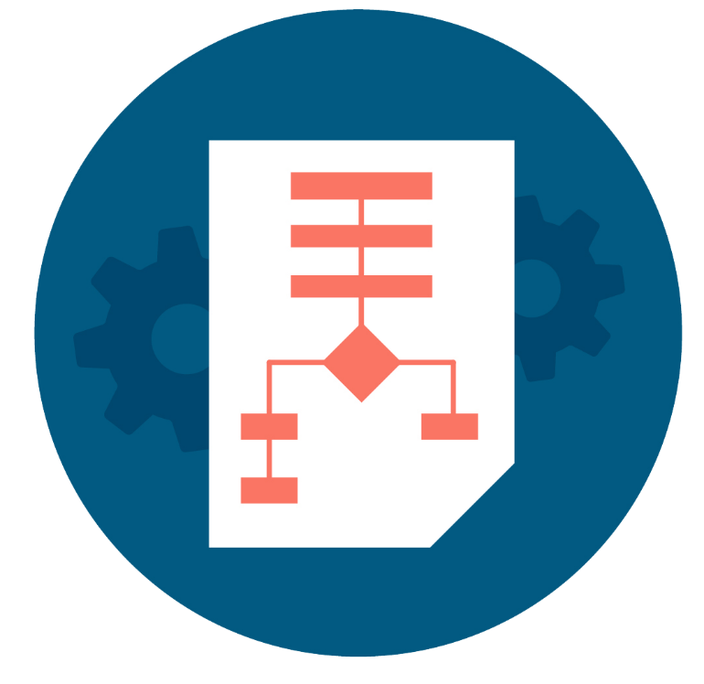
Test Process
Test Activities and Tasks

Slide 28
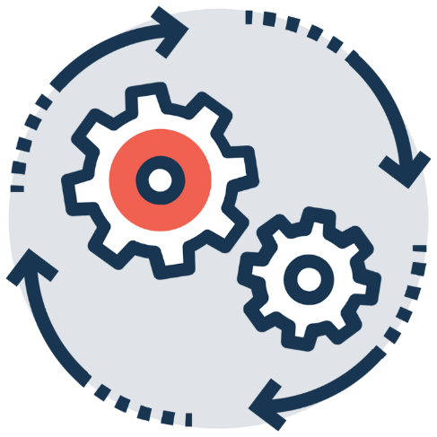
Test Process
Test process is a set of test activities which depend on many factors and the main factor is the organization's test strategy

Slide 29
Test Activities and Tasks
The main groups of activities which are a part of the process
Begin
Test Planning
Test Analysis and Design
Test Implementation and Execution
Exit Criteria and Reporting
Test Closure Activities
End

Slide 30

Psychology of Testing

Slide 31

Human Psychology
Identifying defects may be perceived as criticism
Confirmation bias can make it difficult to accept criticism
As a result, some people perceive testing as a destructive activity
Good communicational skills are a must in order to avoid conflict between developers and QA

Slide 32
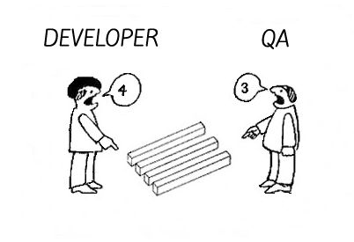
QA vs Devs
QA testers
Are perceived as destructive – only happy when they are finding faults
Usually require good communication skills, tact & diplomacy
Normally need to be multi-talented (technical, testing, team skills)

Slide 33
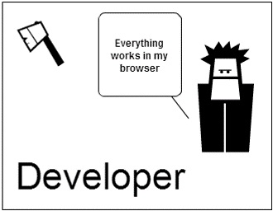
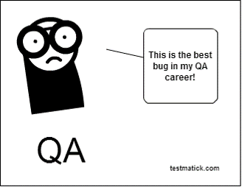
Devs vs QA
Developers
Are perceived as very creative – they write code without which there would be no system
Are rarely good communicators
Can often specialize in just one or two skills (VB, C++, JAVA, SQL)

Slide 34
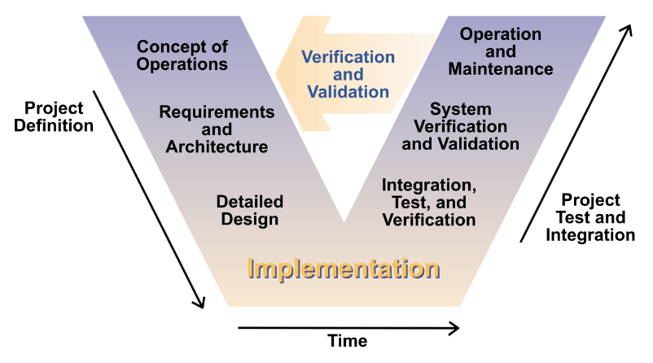
Software Development and Testing

Slide 35
Software Development Lifecycle Model
Describes the stages in the development of a software project and the activities throughout each of them
Requirements
Design
Deployment
Maintenance
Testing
Implementation

Slide 36
Software Testing Life Cycle
Describes the testing phases and the activities throughout the development of a software project
Requirement
Planning
Implementation
Execution
Conclusion
Design
Analysis

Slide 37
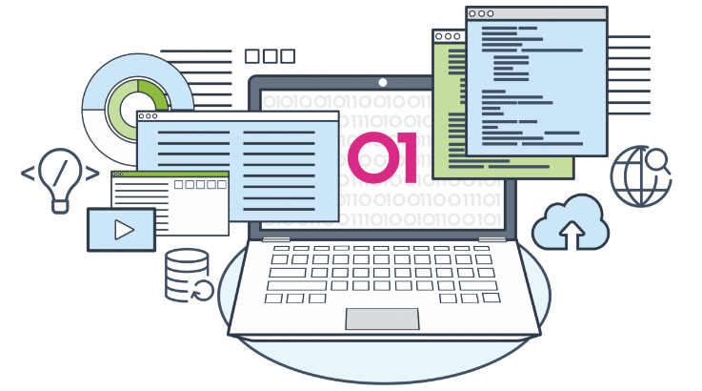
What is a Development Methodology?
A development methodology is a set of practices and procedures for organizing the software development process
Heavyweight and agile methodologies
Heavy methodologies rely on formal procedures and documents
Agile methodologies rely on small iterations and less formalities

Slide 38

Development Methodologies
The "Waterfall" Process
Rational Unified Process (RUP)
Microsoft Solutions Framework (MSF)
Agile development processes
Scrum, Kanban, Lean Development, Extreme Programming (XP), etc.

Slide 39
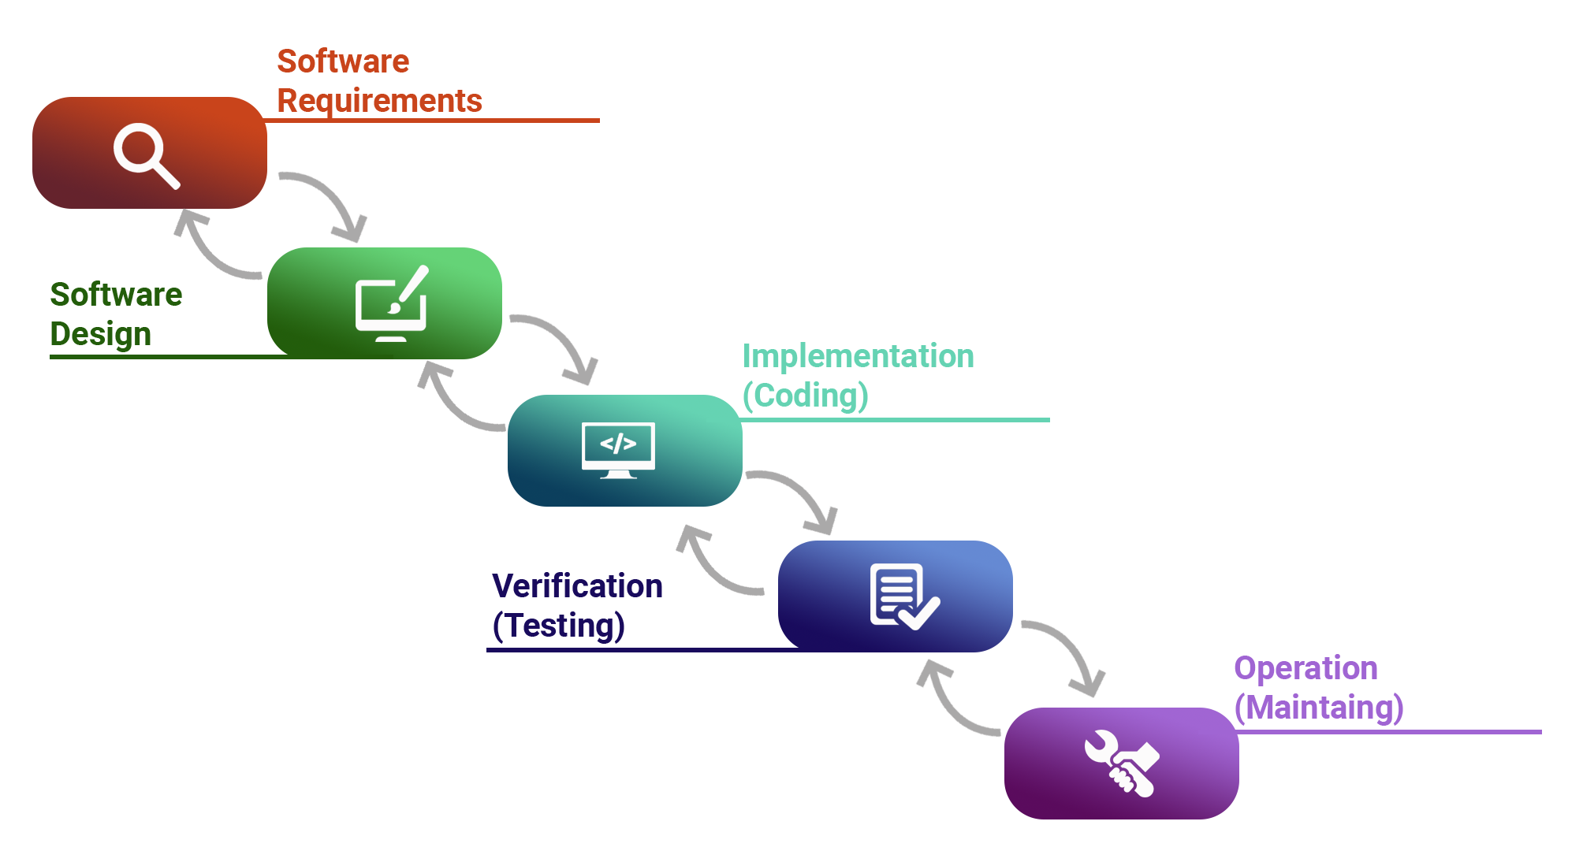
The Waterfall Development Process

Slide 40

The Waterfall Model
The first fundamental model was the "Waterfall" model
Impressively simple and very well known
Only when one development level is completed will be initiated the next one
Only between adjacent levels are there feedback loops and revisions of the previous level
Emphasis is on documentation
Testing is understood as a "one time" action at the end of the development

Slide 41
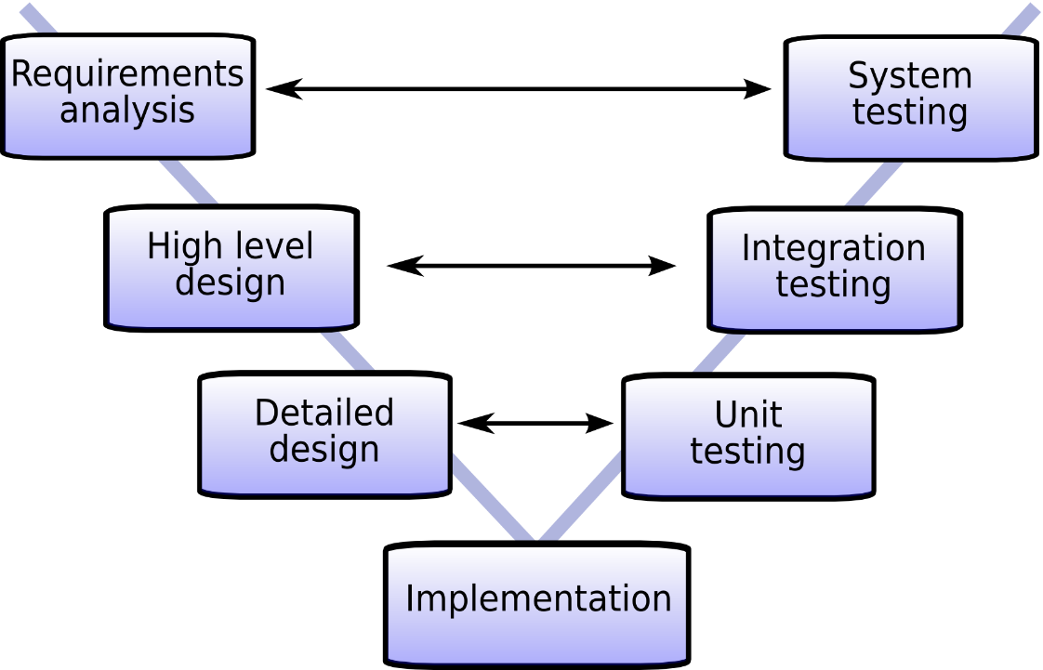
V Model Development Process

Slide 42
V Model
The model presents two branches
Development tasks
The process of design and implementation
Testing tasks
Verification and integration into bigger subsystems
Both are corresponding activities of equal importance

Slide 43
V Model Development Tasks
Requirements' specification
Functional system design
Technical system design
Component specification
Programming / coding

Slide 44
V Model Testing Tasks (1)
Component (unit) test
Verifies each software component
Does it perform correctly according to its specification?
Integration test
Checks groups of components
Do they collaborate correctly according to the technical system design?

Slide 45
V Model Testing Tasks (2)
System test
Verifies the system as a whole
Does it meet the specified system requirements?
Acceptance test
Does the system meet the customer requirements?

Slide 46
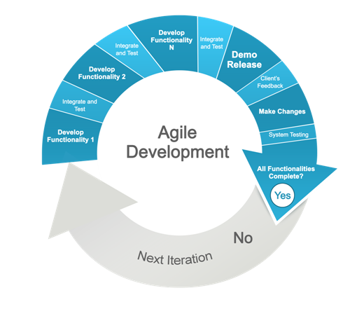
Agile Methodologies
Scrum
Kanban
Lean Software Development
Others

Slide 47

Summary
…
…
…
Definition of testing
Importance
Seven testing principles
Basic definitions of test process activities
Communication between QA's and Developers
SDLC and STLC
Most used development methodologies

Slide 48

Literature
QA Book:
www.istqb.org
Tutorials:
www.w3schools.com
Selenium:
leanpub.com/selenium-webdriver-book
GitHub:
github.com/QualityAssuranceTeam/source

Slide 49
Questions?
Notes:
49

Slide 50













SoftUni Diamond Partners

Slide 51

Educational Partners

Slide 52

License
This course (slides, examples, demos, exercises, homework, documents, videos and other assets) is copyrighted content
Unauthorized copy, reproduction or use is illegal
© SoftUni – https://about.softuni.bg/
© Software University – https://softuni.bg
Notes:
52

Slide 53
Trainings @ Software University (SoftUni)
Software University – High-Quality Education, Profession and Job for Software Developers
softuni.bg, about.softuni.bg
Software University Foundation
softuni.foundation
Software University @ Facebook
facebook.com/SoftwareUniversity
Software University Forums
forum.softuni.bg
Notes:
53

